Slide 1


SIMPLE VECTOR MACHINES (SVM)
OSAGIE ELLIOT AIBANGBEE
Notes:
Good day everyone, my name is Osagie Aibangbee. Please get excited with me as we look at Support Vector Machines (SVM).

Slide 2
STRUCTURE OF PRESENTATION
SLIDE 1: INTRODUCTION TO SUPPORT VECTOR MACHINE
SLIDE 2: ADVANTAGES AND DISADVANTAGES
SLIDE 3: OUTLINE OF SVM
SLIDE 4: SEPARATING HYPERPLANE
SLIDE 5: MAXIMUM MARGIN
SLIDE 6: SOFT MARGIN
SLIDES 7 – 8: KERNEL FUNCTIONS AND TYPES
SLIDES 9 - 15: IMPLEMENTATION IN PYTHON
SLIDE 16: CONCLUSION
SLIDE 17: REFERENCES

Slide 3
INTRODUCTION TO SVM
An advanced machine learning algorithm that divides data points into distinct categories with the help of a separator called the separating hyperplane (decision boundary) .
SVM uses a kernel trick to discover new dimensions at which a non-linearly separable data becomes separable.
The separator (ie.,the hyperplane) can be a point, line, or a plane, depending on the level of dimension at which the data is separated.
Mainly a classification technique (also used for some regression tasks and outlier detection).
Introduced by Vapnik et al. in 1992.
Popular for two reasons:
High accuracy and ability to deal with highly-dimensional data.
A wide range of successful applications:
classification of microarray gene expression profiles, text categorization, image classification, handwriting recognition, weather forecast, etc.
Notes:
SVM is a state-of-the-art machine learning technique that uses a separator called the separating hyperplane to divide data points into distinct categories.
In one dimensional feature space, the separating hyperplane is a point;
In a 2D feature space, the hyperplane is a line;
In higher dimensions, the hyperplane is a plane.
The SVM algorithm uses a mathematical phenomenon called, the kernel trick, to transform otherwise inseparable data points onto higher dimensions at which they become linearly separable.
Although, SVM is widely regarded to be a classification technique, it can also be used to perform regression tasks, as well as outlier detection.
After being introduced by Vapnik et al. in 1992, SVM has since become very popular, especially in the biomedical sector, due to its high accuracy and an ability to deal with highly-dimensional data or inputs that have a non-linear relationship with their outcome.
SVM has a wide range of successful applications in the biomedical sector (i.e., DNA and protein classification), as well as text categorization, image classification, handwriting recognition, weather forecast, etc.

Slide 4
ADVANTAGES
DISADVANTAGES
Popular for making predictions with high accuracy.
Performs well on data with non-linear relationships.
High-dimensional data are handled relatively well.
Only has few modifiable hyperparameters, making it simple to use.
Computationally expensive.
Largely considered to be one of the black box algorithms.
Less control over the model performance.
Notes:
ADVANTAGES OF USING SVM include:
It’s known for making predictions with high accuracy.
Performs well on data with non-linear relationships between the input variables and their outcome.
Performs relatively well on datasets with large number of features or dimensions.
It simple to use because it only has very few adjustable hyperparameters.
DISADVANTAGES OF USING SVM are as follows:
It can be computationally expensive to implement or run.
It belongs to the class of black box algorithms, as the relationship(s) between input features and outcome are not easily understood. Especially when the relationship is non-linear.
There is relatively less control over model performance due to having very few modifiable hyperparameters.

Slide 5
WHAT IS A SUPPORT VECTOR MACHINE?
There are two types of SVM algorithms, depending on the kernel function:
Linear and non-linear
Linear kernel function deals with linearly-separable classes.
Non-linear kernel function deals with non-linearly separable data.
To gain a better understanding of the workings of the support vector machine, 4 integral concepts shall be examined:
The separating hyperplane
The maximum margin
The soft margin
The kernel function
Notes:
For instance, in a two-dimensional feature space, the goal of an SVM algorithm would be to identify a line that best separates the data points from both features.
The SVM algorithm uses kernel functions to perform transformations on input variables. These transformations are simply mathematical computations.
The kernel functions can be classified into two main categories:
Linear and non-linear kernel functions
As the names imply:
A linear kernel function handles linearly-separable data.
A non-Linear kernel function deals with non-linearly separable data by projecting it onto higher-dimensions until they becomes linearly-separable.
To better understand how SVM works, we shall consider 4 important concepts:
The separating hyperplane
The maximum margin
The soft margin
The kernel function

Slide 6
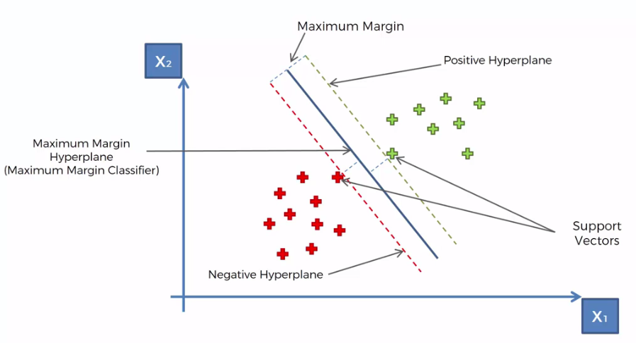
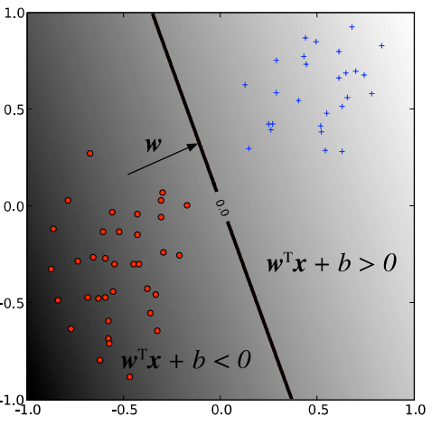
THE SEPARATING HYPERPLANE
Hyperplane is the equivalent of a straight line in a high-dimensional space.
The hyperplane is positioned such that it is as far as possible from the supporting vectors (i.e. in between the positive hyperplane and negative hyperplane).
Mathematically , the decision boundary (points x such that w^{T} • x + b = 0) divides the plane into two sets depending on the sign of w^{T} x + b.
Positive class: where w^{T} x + b > 0 ➔ +1
Negative class: where w^{T} x + b < 0 ➔ -1
https://1.bp.blogspot.com/-K8qVBF8FKpk/WVnU0CDKPzI/AAAAAAAABy4/X-otWS8WuickSKOu0JNEjergkePulalZQCLcBGAs/s1600/Capture.PNG
Figure 1 (A User’s Guide to Support Vector Machines by Asa B. and Weston J.)
Notes:
The top figure illustrates that the decision boundary comprises 3 elements:
Optimal or separating hyperplane, positive hyperplane, and negative hyperplane.
The optimal hyperplane is a straight-line equivalent which separates data points into classes in high-dimensional space. Its position in space is determined by the supporting vectors – the data point(s) of one class that are nearest to the other.
The hyperplane tries to keep the decision boundary as wide as possible between both classes, which also optimises the accuracy of the algorithm.
Mathematically, the separating hyperplane is the point of x where the equation: w transposed x plus b evaluates to zero.
The point at which the equation evaluates to +1 is called the positive hyperplane, while the negative hyperplane is where it evaluates to -1.
Therefore, the algorithm uses the decision boundary elements to classify data points into the positive or negative class.

Slide 7
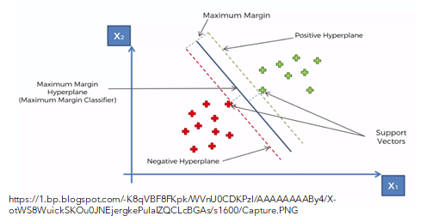
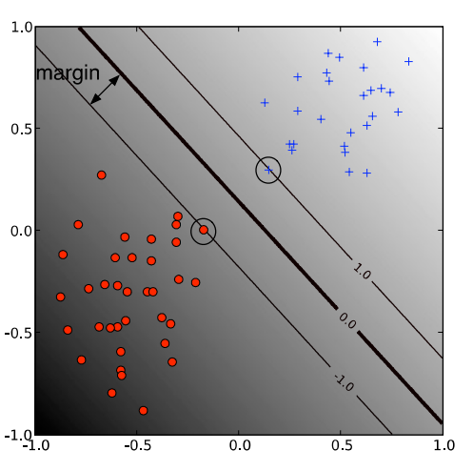
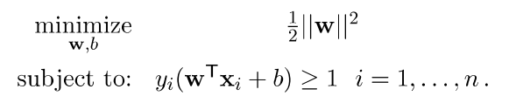
MAXIMUM MARGIN
A margin is the geometric distance between the closest point in dataset to the hyperplane.
The distance between the positive hyperplane and negative hyperplane is called the maximum margin.
The hyperplane maximises the width of the decision boundary between both classes.
Mathematically, the maximum margin classifier is the function that maximises 1/||w||, which is equivalent to minimizing ||w||². ||w|| is length of vector w.
Maximum margin is given by:
Figure 2 (A User’s Guide to Support Vector Machines by Asa B. and Weston J.)
Notes:
As shown in the bottom figure, a margin is the geometric distance of the closest point in the dataset to the separating hyperplane. It’s assumed that the positive and negative hyperplanes are equidistant from the separating hyperplane.
The distance from the positive hyperplane to negative hyperplane is called the maximum margin. It covers the entire distance of the decision boundary, and the separating hyperplane resides at the central position within it.
Mathematically, the maximum margin classifier is the discriminant function that maximises 1/length of vector w, which is equivalent to minimizing length of vector w squared.
The formula for maximum margin is shown here.

Slide 8
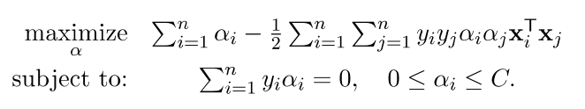
SOFT MARGIN
Hard margin (applicable to linearly separable dataset) is modified to handle non-separable data by maximizing the margin and allowing the algorithm to misclassify data points to some degree.
In essence, the soft margin allows some data points to “escape” through the margin of the separating hyperplane without affecting the end goal.
Mathematically, the formula for this operation is:
Notes:
Hard margin SVM which assumes a dataset is linearly separable is modified to handle non-linearly separable data by maintaining a maximum margin and allowing the algorithm to misclassify data points to some degree. Performing this results in a softer version of the SVM called soft margin SVM.
In essence, the soft margin allows some points in the dataset to “escape” through the margin of the separating hyperplane without affecting the positioning of the decision boundary.
And here is the formula for this operation (points)
Alpha subscript i and b both determine the position of the decision boundary.
While C is the hyperparameter that controls the orientation of the decision boundary as well as the width of the margin error.

Slide 9
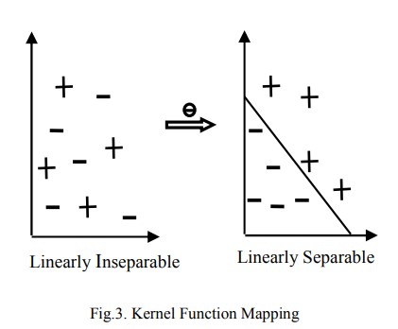
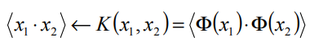
KERNEL FUNCTION
Kernel function projects data from its low-dimension onto a space of higher dimensions.
For instance, it is what allows the SVM to perform three-dimensional classification on a dataset with one or two dimensions.
Formula is:
Types of kernel functions:
Linear Kernel Function
Polynomial Kernel Function
Radial Basis Function (RBF)
Sigmoid Kernel Function
Notes:
This diagram perfectly illustrates what a kernel function is all about.
In lay terms, kernel functions are mathematical computations performed by the algorithm on datasets that are not linearly separable.
A kernel function generally projects data from its original number of dimensions to a higher-dimensional space in which it becomes separable.
Types of kernel functions are based on the type of transformations they perform, and they include:
The Linear kernel,
Polynomial kernel,
Radial Basis Function or rbf.
Sigmoid kernel

Slide 10
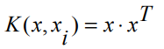
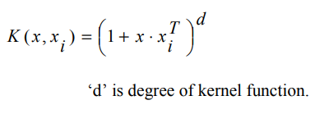
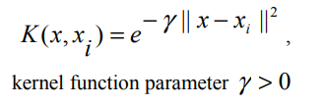
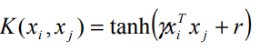
TYPES OF KERNEL FUNCTIONS
LINEAR KERNEL FUNCTION ➔
POLYNOMIAL KERNEL FUNCTION ➔ K(x, x_{i}) = (1 + x • x_{i}^{T})^{d}
RADIAL BASIS FUNCTION (RBF) ➔
SIGMOID KERNEL FUNCTION ➔
KEYS:
x = input vector
w = weight vector
b = bias
superscript T = transpose notation
subscript i = index notation
d = polynomial degree
Y = RBF gamma
||x|| = magnitude/length of vector x
r = sigmoid kernel parameter
Notes:
The Linear Kernel, which performs efficient linear transformations on data.
The Polynomial Kernel, which is directional in the way it operates. Its output depends on the direction of the two vectors, x and x subscript i, and its output length also depends on the magnitude of x subscript i.
The Radial Basis Function, which is the most popular of all SVM kernel functions, as it adds a ‘bump’ around each data point.
And the Sigmoid Kernel which is shown here.
Hyperparameters, gamma and polynomial degree, each control the flexibility or curvature of their decision boundaries.

Slide 11
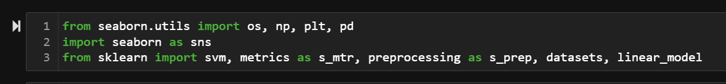
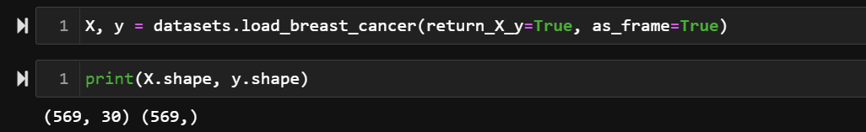
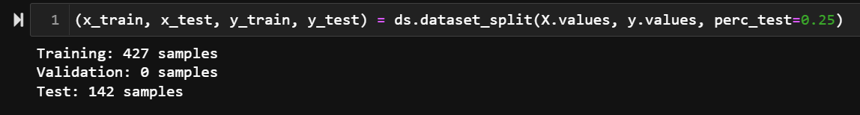
IMPLEMENTATION IN PYTHON
1. Import pandas, numpy, seaborn and matplotlib.pyplot for data manipulation
2. Load the dataset, and check shape of dataframe
3. Split X and y variables each into training and evaluation sets using my customized function
Notes:
Now let’s look at how an SVM classifier is implemented in Python through Scikit-Learn’s svm module. The breast cancer dataset used for this classification task is downloadable through Scikit-Learn’s dataset module.
So, firstly I imported all necessary modules including the svm module from sklearn.
Next, I read in the dataset and found a total of 569 rows, and 31 columns. However, the columns were broken into 30 input variables (X) and 1 outcome variable (y).
Note: y has two labels 0 which denotes a malignant outcome, and 1 which denotes a benign outcome.
Next, the X and y variables were each split into a training and test set. Resulting in 427 and 142 entries for model training and evaluation respectively.

Slide 12

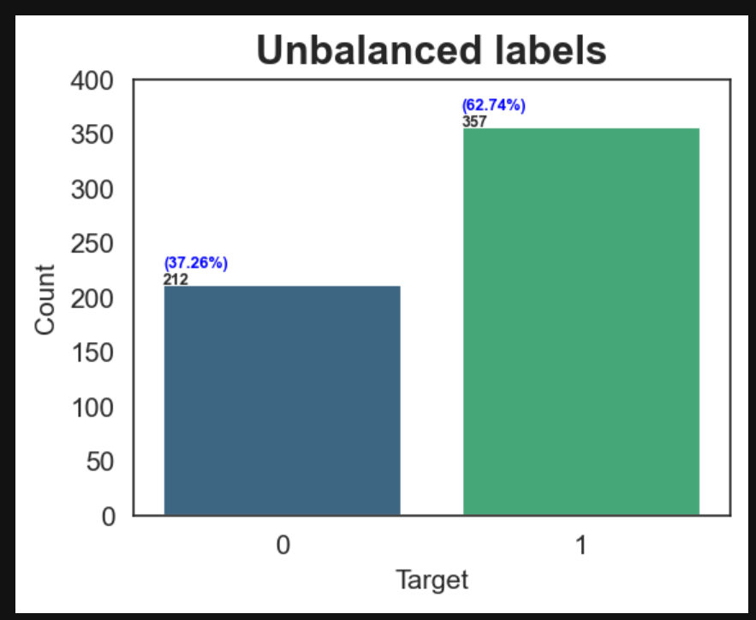
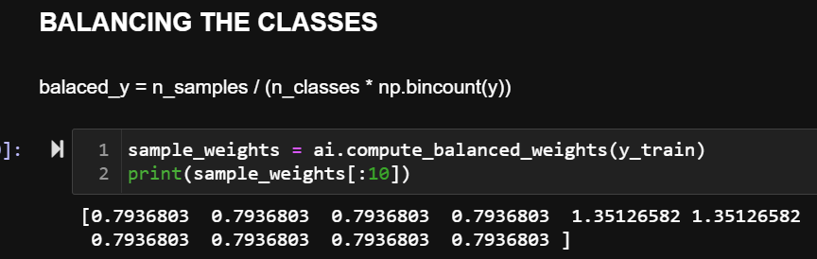
4. Visualize the balance of labels in the y variable using my customized function
5. Compute the sample weights for the algorithm to use during training to nullify the effect of the ‘heavier’ class 1 samples.
Benign
Malignant
Notes:
Before going any further, I checked to see if both classes had equal number of cases but found that the class distribution were approximately at a ratio of 2:1 in favor of the benign class.
In response to this situation, I computed (using the formula shown below) the weight per class for each instance label to be used by the model during training to nullify the unbalanced nature of the data labels.

Slide 13
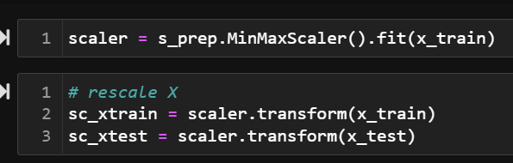
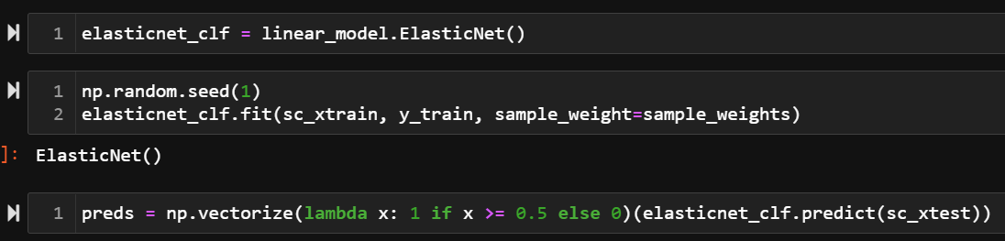
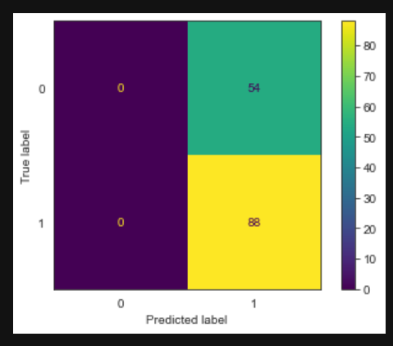
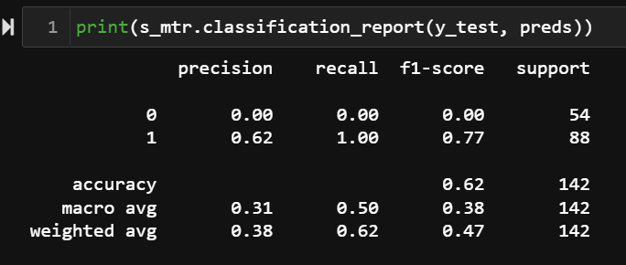
6. Rescale X variables to fall between 0 and 1 using sklearn’s preprocessing.MinMaxScaler
7. Classification with logistic regression (i.e. default configuration of sklearn’s elasticnet)
Notes:
Next, I rescaled the X variables to fall between 0 and 1.
Then, I trained an elasticnet logistic regression model on our 30-dimensional input data and passed in the sample weights (computed earlier) to the algorithm for balanced training.
Upon evaluation, we can see that the model predicted everything as class 1 samples, showing its inability to distinguish between samples of each class.

Slide 14
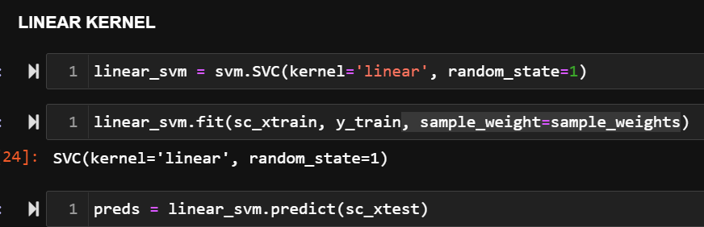
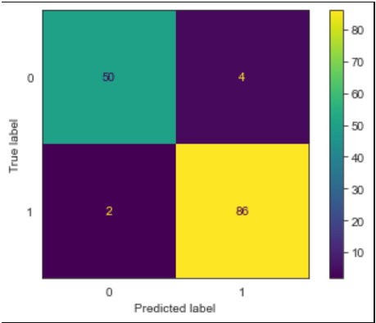
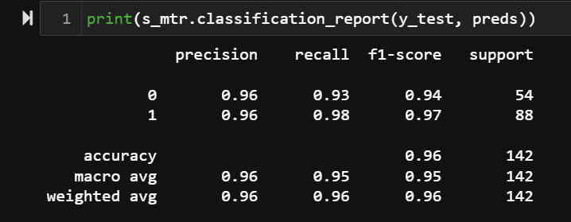
8. Classification with a LINEAR SVM classifier (i.e. default configuration of sklearn’s svm.SVC)
9. Evaluate model’s performance (accuracy, recall, precision, f1-score)
Notes:
Next, I trained and evaluated a linear SVM classifier on the data.
With an accuracy of 96%, the linear SVM is superior to the elasticnet classifier, as it was able to separate data points into their correct classes while allowing for some misclassifications.

Slide 15
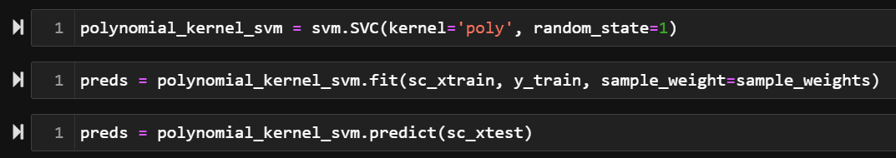
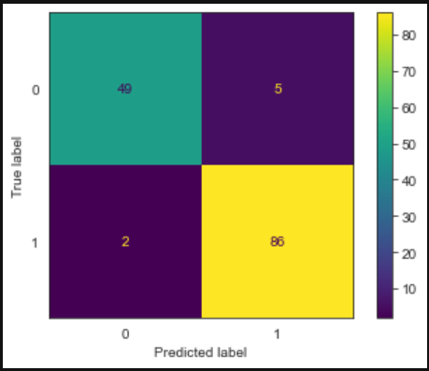
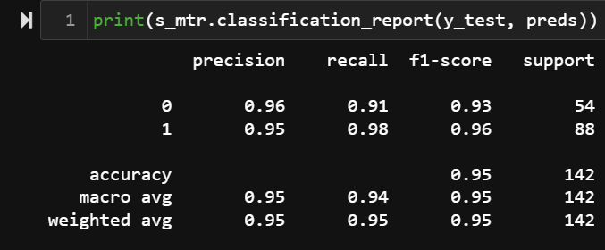
10. Classification with a POLYNOMIAL SVM classifier (i.e. default configuration of sklearn’s svm.SVC)
11. Evaluate model’s performance (accuracy, recall, precision, f1-score)
Notes:
After the training and evaluation of a polynomial svm classifier, we can see a similar result to the linear svm except for a 1% decrease in accuracy.

Slide 16
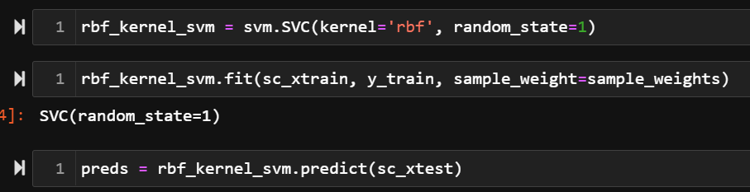

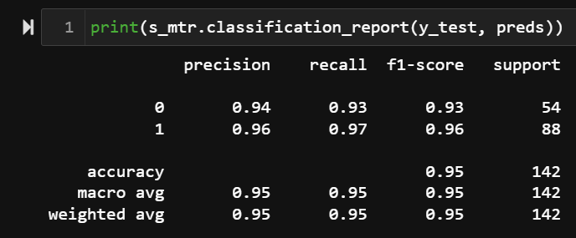
12. Classification with an RBF SVM classifier (i.e. default configuration of sklearn’s svm.SVC)
13. Evaluate model’s performance (accuracy, recall, precision, f1-score)
Notes:
The radial basis function SVM also performs excellently with 95% accuracy.

Slide 17
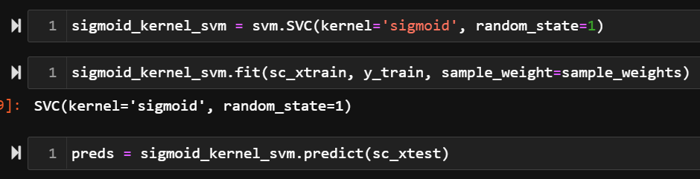
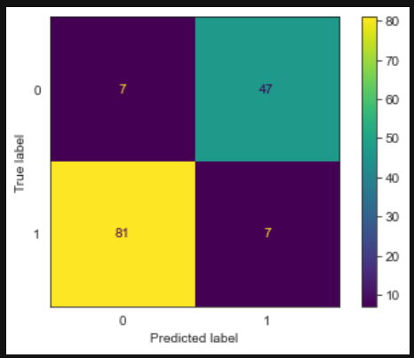
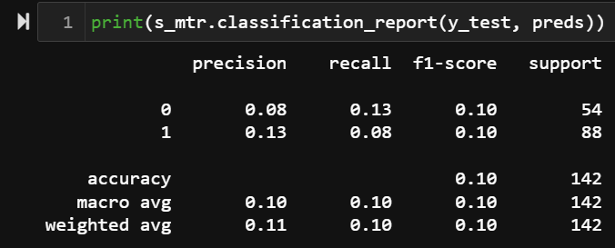
14. Classification with an SIGMOID SVM classifier (i.e. default configuration of sklearn’s svm.SVC)
15. Evaluate model’s performance (accuracy, recall, precision, f1-score)
Notes:
We can see that the sigmoid svm failed woefully with an accuracy of 10% which indicates that a sigmoid kernel is unsuitable for this task.

Slide 18
CONCLUSION
Support Vector Machines has its place among elite algorithms due to its ability to accurately predict an outcome regardless of the dimensionality of the input data.
Selecting the right kernel function is not fixed, as it’s task and data dependent.
Notes:
In conclusion:
SVM obviously has its place among elite algorithms due to its ability to accurately predict an outcome regardless of the dimensionality of the input data.
Selecting the most suitable kernel function is task and data dependent.

Slide 19
REFERENCES
Asa B. & Jason W. (2010) A User’s Guide to Support Vector Machines. Methods in Molecular Biology (Clifton, N.J.).
Nobel W. S. (2006) What is a Support Vector Machine? Nat Biotechnol. 24(12):1565-7
Patle A. & Chouhan D. S., (2013) SVM kernel functions for classification. 2013 International Conference on Advances in Technology and Engineering (ICATE),1-9.
Notes:
Thank you.

